Slide 1
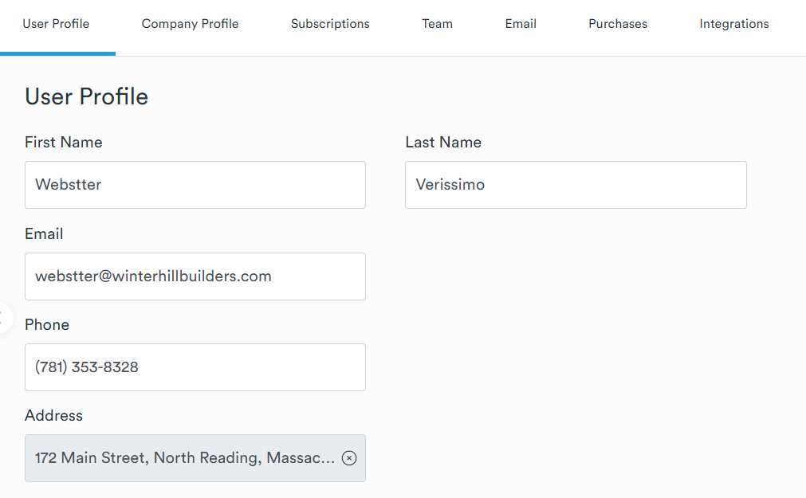
LOGO
Settings
Customers
Quotes
Price List

Slide 2
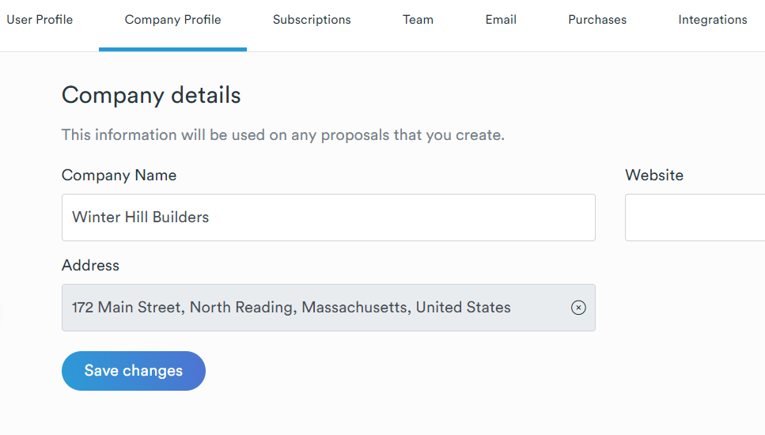
LOGO
Settings
Customers
Quotes
Price List

Slide 3
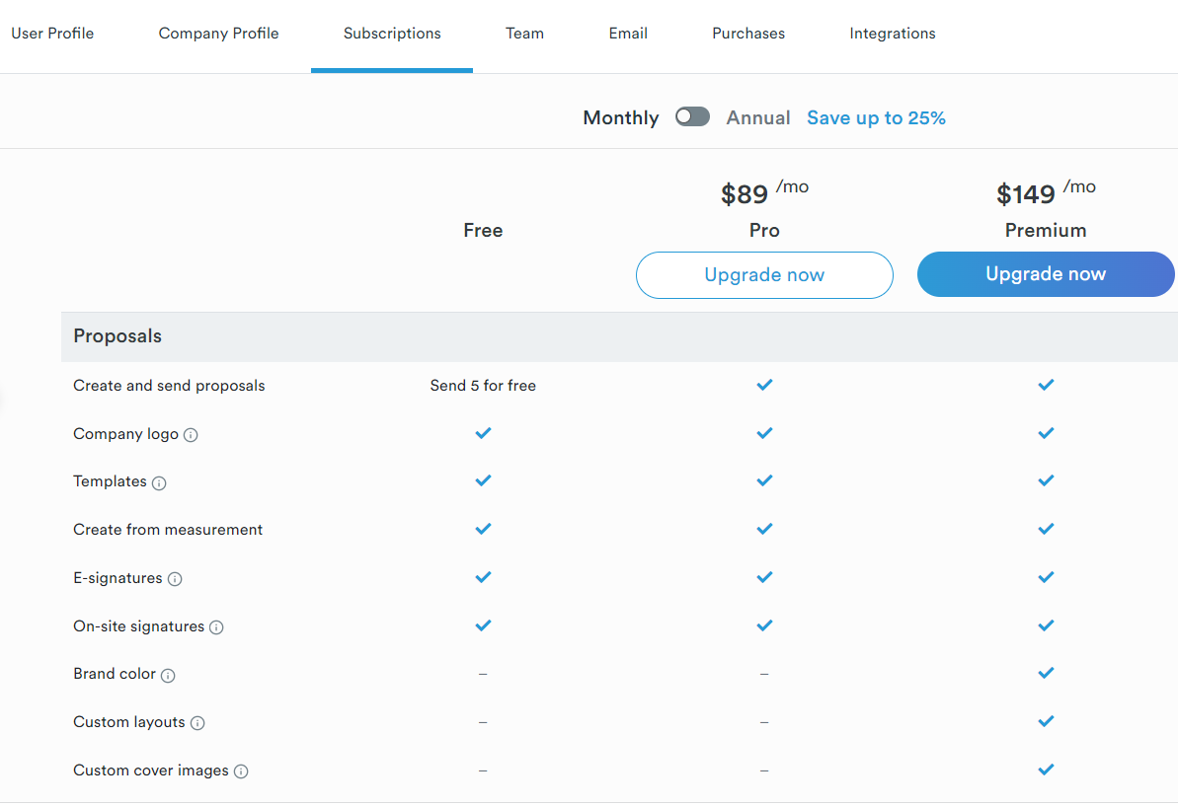
LOGO
Settings
Customers
Quotes
Price List

Slide 4
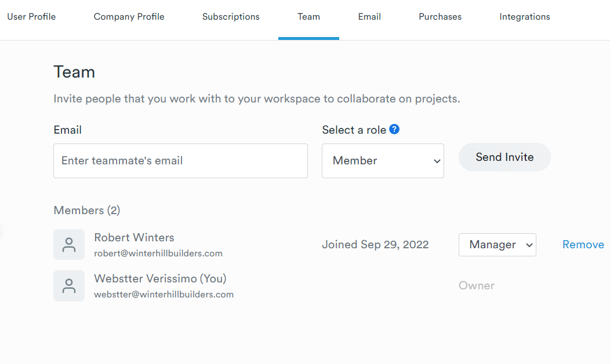
LOGO
Settings
Customers
Quotes
Price List

Slide 5
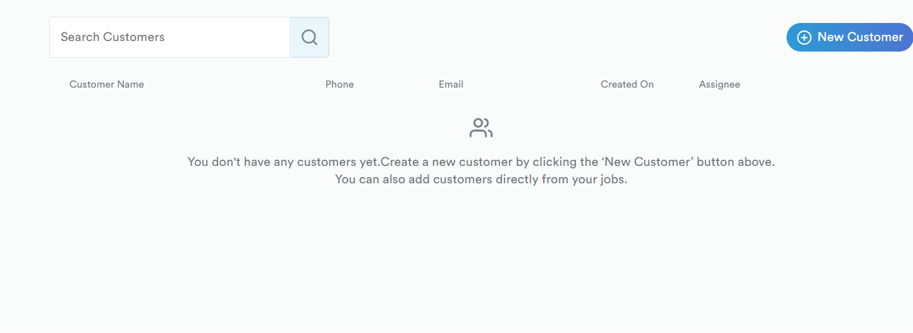

LOGO
Settings
Quando o customer for selecionado, deve levar para pagina dele. Mastrar todos os quotes que temos com ele
Customers
Quotes
Dados
Price List
Decking
Roofing Siding
Quotes
+ New Quote
Clone
Edit

Slide 6
Decking
Roofing Siding
LOGO
Settings
Customers
Search Quote
+ New Quote
Quotes
Address
Customer
Quote#
Quote Type
Total Cost
Profit
Notes
Quote Type
Profit %
1 Franklin
Joao
01100
Decking
$10,000
$2,500
25%
Deck e uma porta
Price List
Quando o quote for selecionado, deve levar para pagina dele. Mastrar todos os dados do quote

Slide 7
LOGO
Settings
Deck
Customers
Customer Info
Deck Take-Off
Estimate
Material Order
Quotes
Customer: Joao das flores
Address: 1 Franklin St Boston
Land Line:
Cell Phone:
Email:
Price List

Slide 8
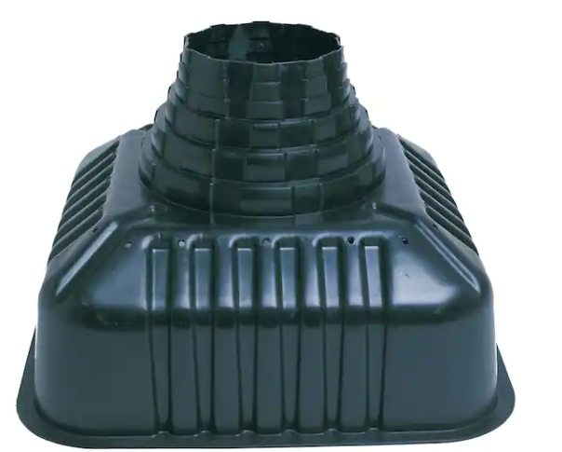
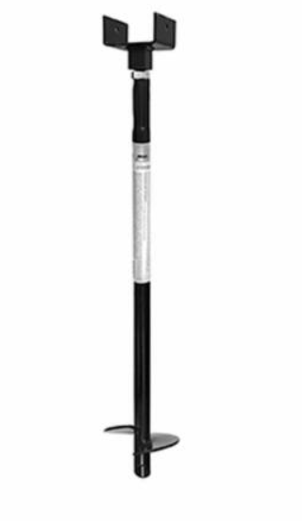
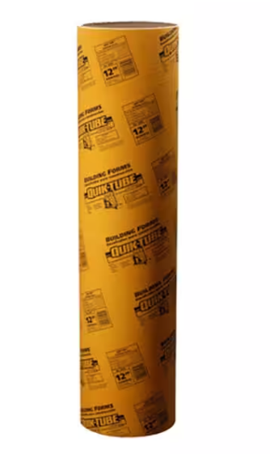
LOGO
Settings
Customers
Quote Info
Deck Take-Off
Estimate
Material Order
Quotes
Price List
Size
Qt
Footing
Big Foot
2
20x20x20
Frame
Railing System
Finishing
Size
Helical Post
Qt
RainScape
1
3” x 5’
Extra Materials
Labor
Qt
Size
Sonotubes
2
12” x 4’

Slide 9
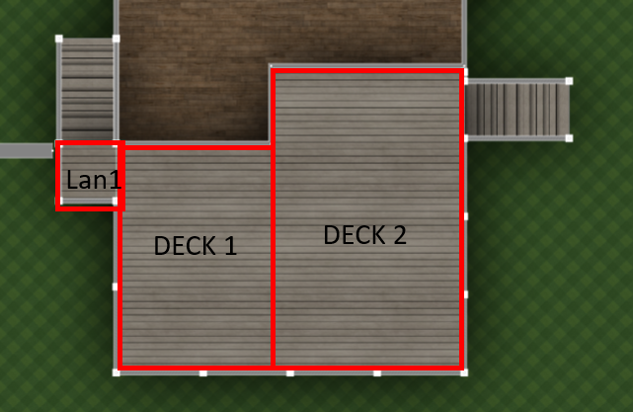
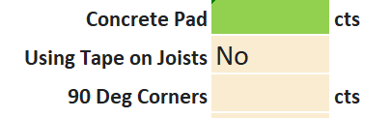
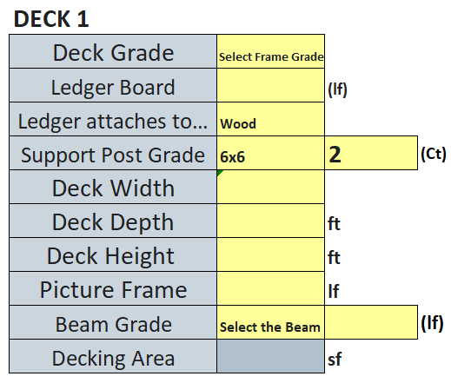
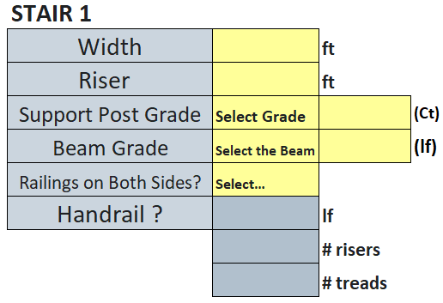
LOGO
Settings
Customers
Quotes
Price List
Quote Info
Deck Take-Off
Estimate
Material Order
Footing
Deck 1
Deck 2
Stair 1
Layout
Railing System
Finishing
RainScape
Landing 1
Landing 2
Stair 2
Extra Materials
Labor

Slide 10
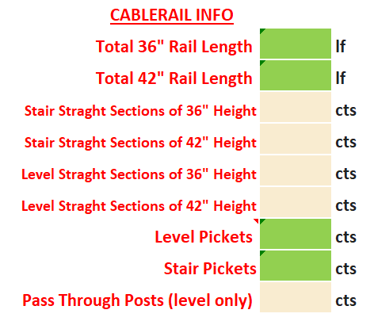
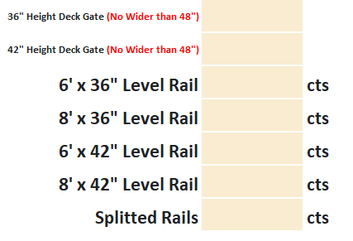
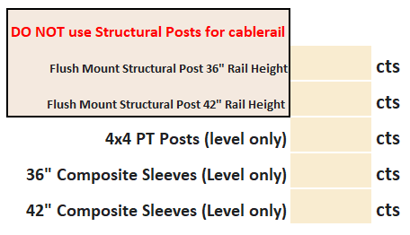
LOGO
Settings
Customers
Quote Info
Deck Take-Off
Estimate
Material Order
Quotes
Price List
Footing
Frame
Railing System
Finishing
RainScape
Extra Materials
Labor

Slide 11
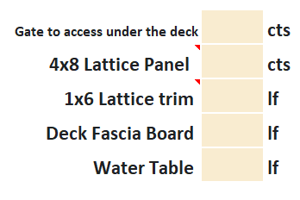
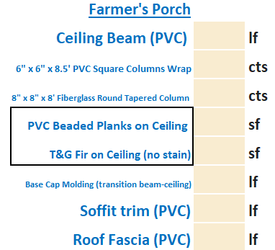
LOGO
Settings
Customers
Quote Info
Deck Take-Off
Estimate
Material Order
Quotes
Price List
Footing
Frame
Railing System
Finishing
RainScape
Extra Materials
Labor

Slide 12
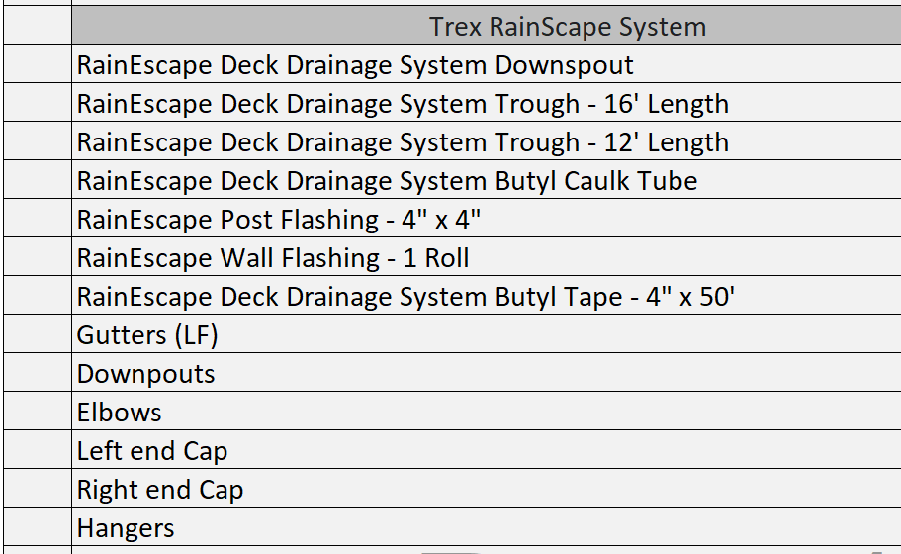
LOGO
Settings
Customers
Quote Info
Deck Take-Off
Estimate
Material Order
Quotes
Price List
Footing
Frame
Railing System
Finishing
RainScape
Extra Materials
Labor

Slide 13
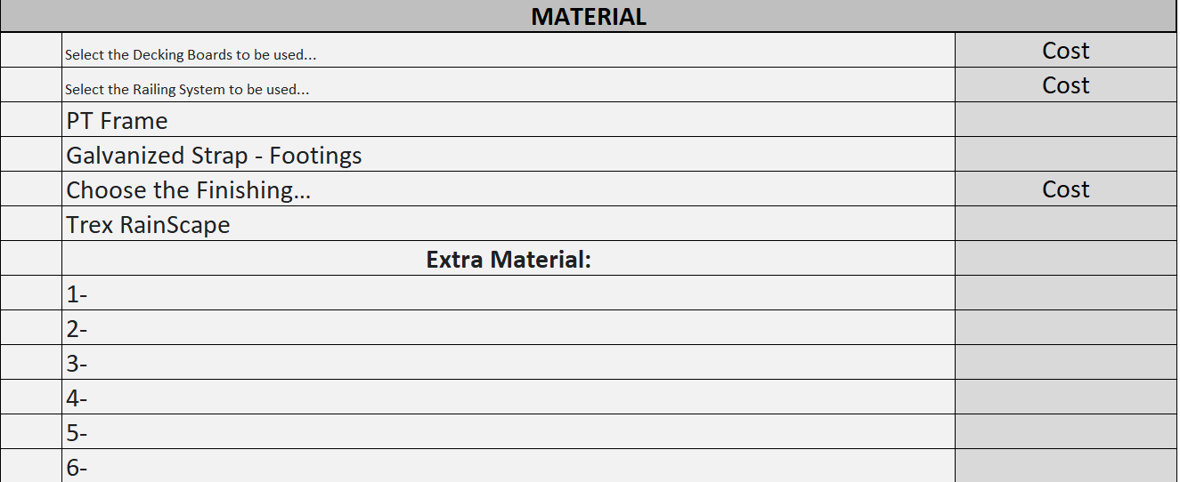
LOGO
Settings
Customers
Quote Info
Deck Take-Off
Estimate
Material Order
Quotes
Price List
Footing
Frame
Railing System
Finishing
RainScape
Extra Materials
Labor

Slide 14
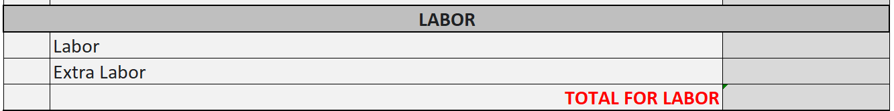
LOGO
Settings
Customers
Quote Info
Deck Take-Off
Estimate
Material Order
Quotes
Price List
Footing
Frame
Railing System
Finishing
RainScape
Extra Materials
Labor

Slide 15
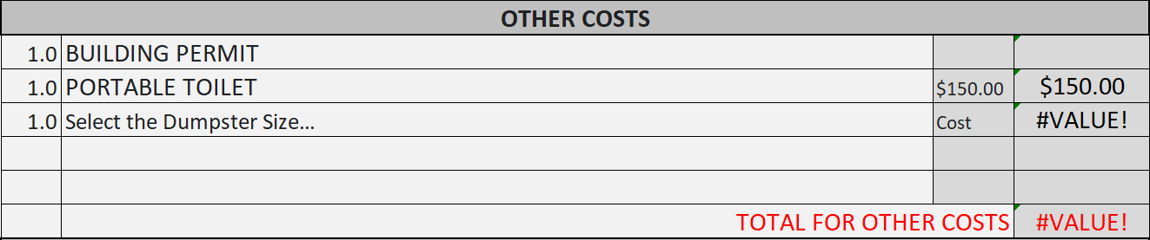
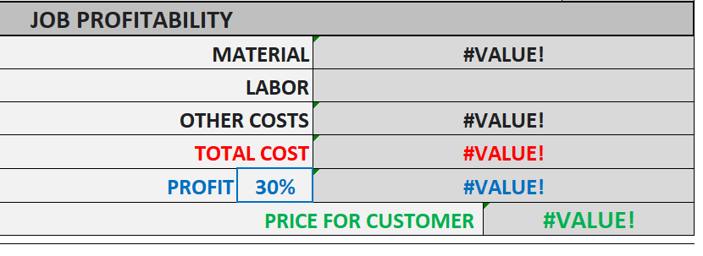
LOGO
Settings
Customers
Quote Info
Deck Take-Off
Estimate
Material Order
Quotes
Price List
General
(X – Y) View
PRINT

Slide 16
LOGO
Settings
Customers
Quote Info
Deck Take-Off
Estimate
Material Order
Quotes
Price List
General
RAILINGS
A
B
C
D
E
F
(X – Y) View
A
$1200
$1200
B
$1200
DECKING
C
$1200
D
E

Slide 17
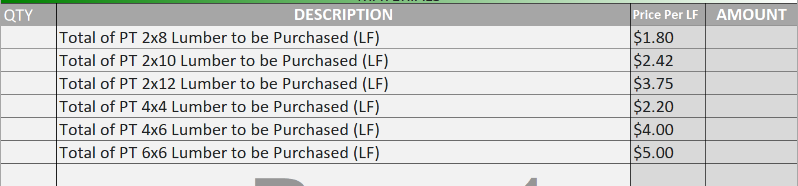
LOGO
Settings
Customers
Quote Info
Deck Take-Off
Estimate
Material Order
Quotes
Price List
Pressure Treated
Pressure Treated Take off by LF
Pressure Treated Order List
Galv. Strap Fasteners Footings
Finishing
Decking
Railings
RainScape
Extras
Print Order

Slide 18
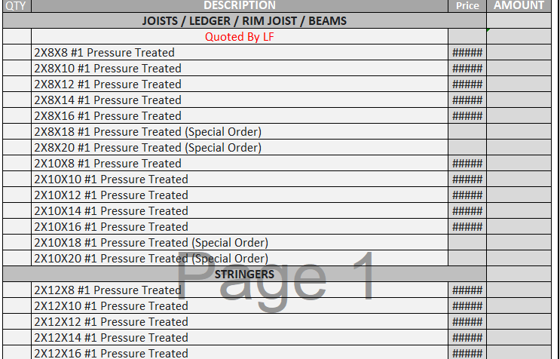
LOGO
Settings
Customers
Quote Info
Deck Take-Off
Estimate
Material Order
Quotes
Price List
Pressure Treated
Pressure Treated Take off by LF
Pressure Treated Order List
Galv. Strap Fasteners Footings
Finishing
Decking
Railings
RainScape
Extras
Print Order

Slide 19
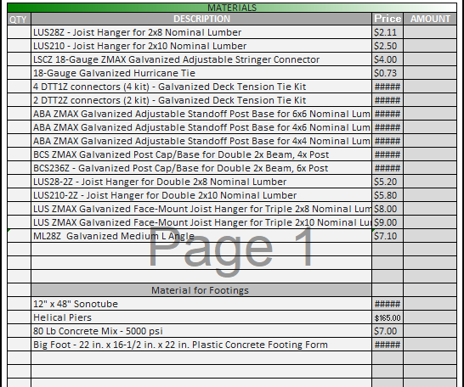
LOGO
Settings
Customers
Quote Info
Deck Take-Off
Estimate
Material Order
Quotes
Price List
Pressure Treated
Galv. Strap Fasteners Footings
Finishing
Decking
Railings
RainScape
Extras
Print Order

Slide 20
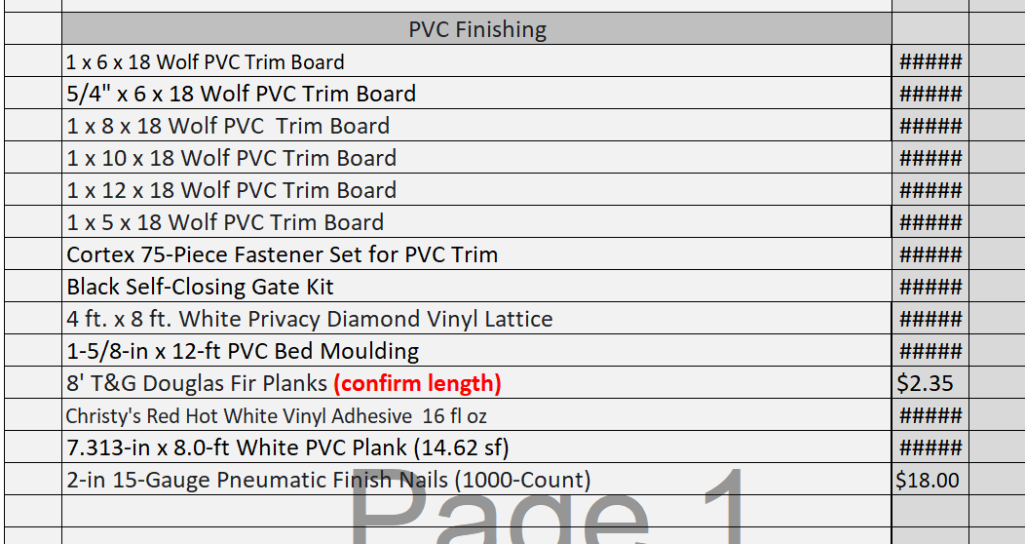
LOGO
Settings
Customers
Quote Info
Deck Take-Off
Estimate
Material Order
Quotes
Price List
Pressure Treated
Galv. Strap Fasteners Footings
Finishing
Decking
Railings
RainScape
Extras
Print Order

Slide 21
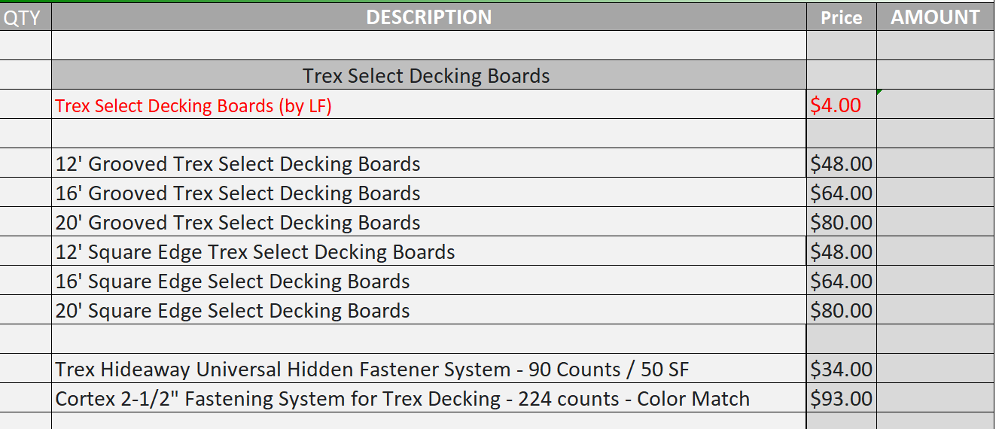
LOGO
Settings
Customers
Quote Info
Deck Take-Off
Estimate
Material Order
Quotes
Price List
Pressure Treated
Galv. Strap Fasteners Footings
Finishing
Decking
Railings
RainScape
Extras
Print Order

Slide 22
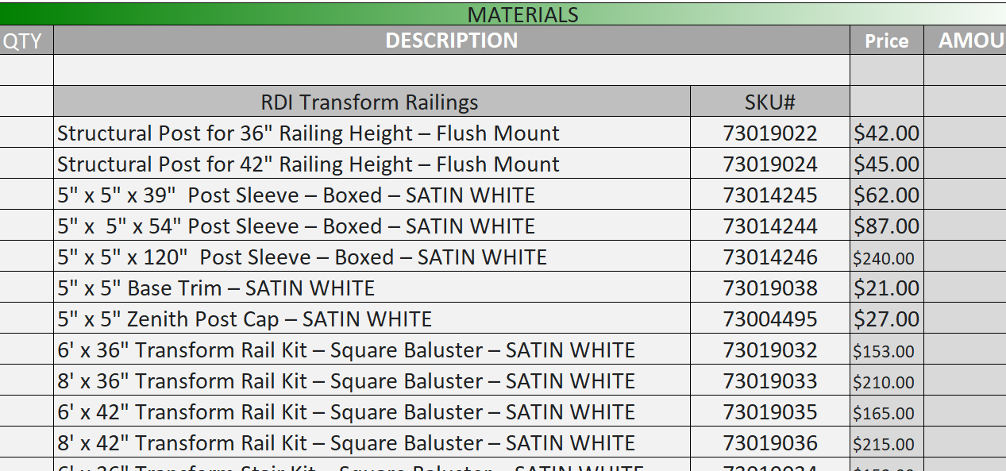
LOGO
Settings
Customers
Quote Info
Deck Take-Off
Estimate
Material Order
Quotes
Price List
Pressure Treated
Galv. Strap Fasteners Footings
Finishing
Decking
Railings
RainScape
Extras
Print Order

Slide 23
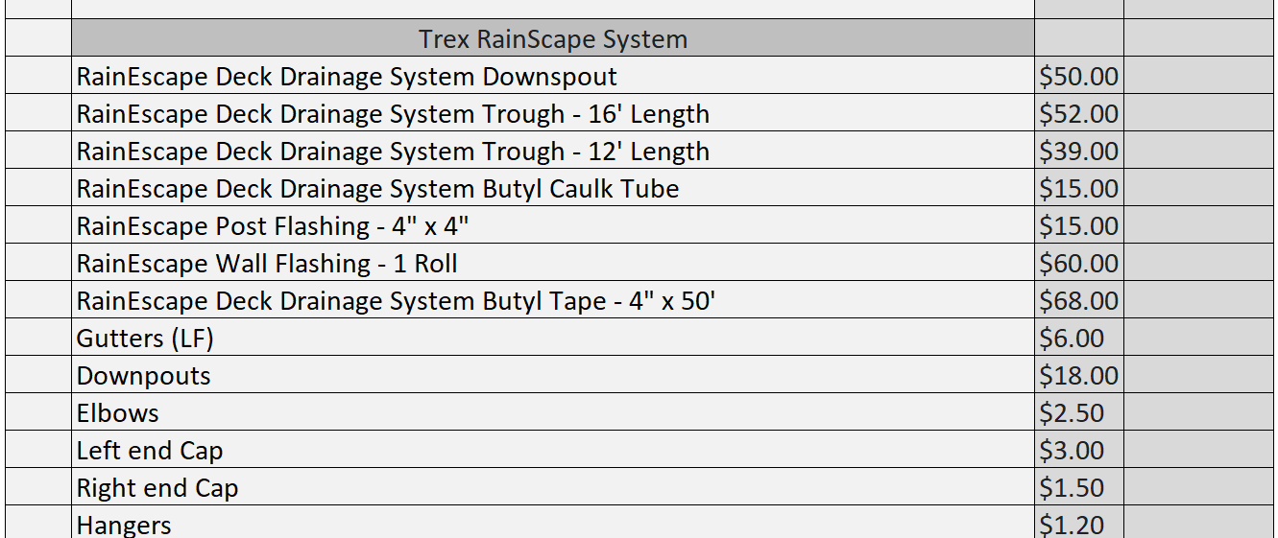
LOGO
Settings
Customers
Quote Info
Deck Take-Off
Estimate
Material Order
Quotes
Price List
Pressure Treated
Galv. Strap Fasteners Footings
Finishing
Decking
Railings
RainScape
Extras
Print Order

Slide 24
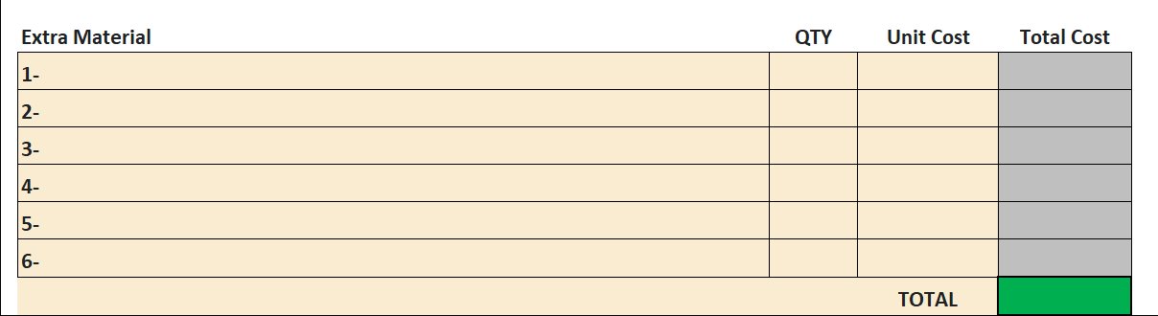
LOGO
Settings
Customers
Quote Info
Deck Take-Off
Estimate
Material Order
Quotes
Price List
Pressure Treated
Galv. Strap Fasteners Footings
Finishing
Decking
Railings
RainScape
Extras
Print Order

Slide 25
LOGO
Settings
Customers
Quote Info
Deck Take-Off
Estimate
Material Order
Quotes
Price List
Pressure Treated
Pressure Treated
Galv. Strap Fasteners Footings
Galv. Strap Fasteners Footings
Finishing
Railings
Finishing
RainScape
Decking
Extras
Railings
RainScape
All
Extras
PRINT
Print Order

Slide 26
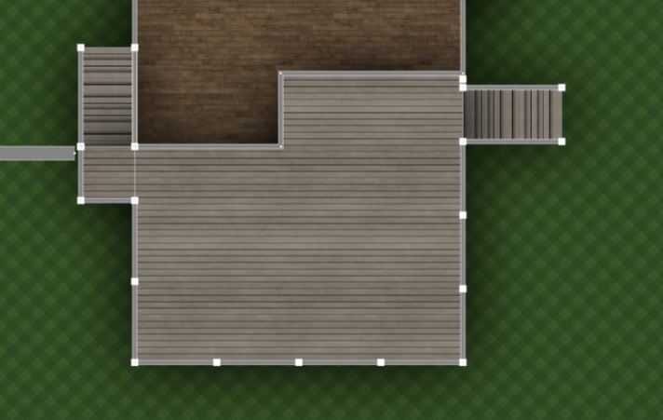
Lan1
DECK 1
DECK 2

Slide 27
